Slide 1
Using MariaDB SQL
First create a database
P Blanchfield

Slide 2
Start up Putty
Or some other SSH client
And connect to Mersey

Slide 3
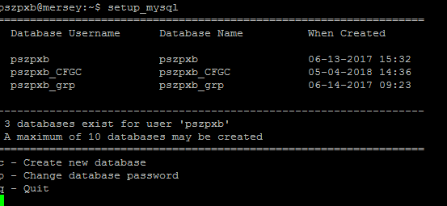
Go to the help page on cs.nott.ac.uk
http://support.cs.nott.ac.uk/help/docs/databases/
And choose
http://support.cs.nott.ac.uk/help/docs/databases/mysql/using-mysql.html
The command you need to use is
setup_mysql

Slide 4
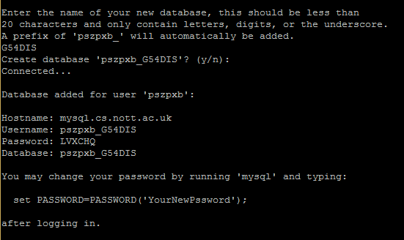
Create a new database
I have a few already I will call mine G54DIS

Slide 5
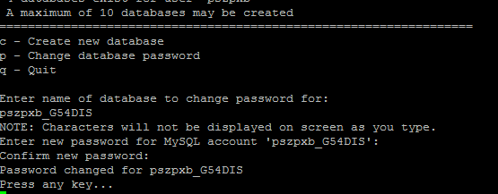
Change the password now

Slide 6
Now quit and log on to mysql
You need
mysql –u pszpxb_G54DIS –p pszpxb_G54DIS
Or whatever you called your database
You will be prompted for your password
Don’t forget it and make sure to use a strong one

Slide 7
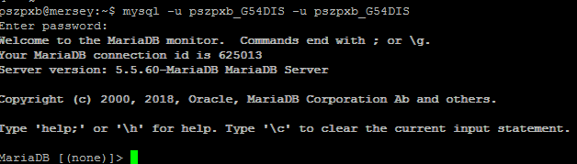
You are now in MariaDB

Slide 8
Notice
Commands end with a “;”
Forgetting this will end in misery.
You can also use \g
But I don’t know why you would want to
There are some useful commands that will be useful to remember but will be useless for the moment
show tables;
desc <tablename>;
As we don’t have any tables yet we will not be able to use them yet
But once you forget how you spell your tables or what they look like they become useful

Slide 9
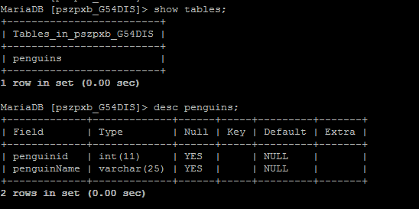
Example

Slide 10
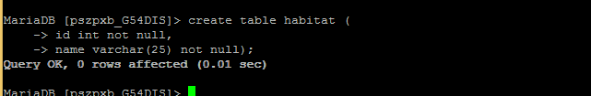
Add a Habitat table
Not null means it has to be have a value
int means the data is an integer
varchar(25) means it is a string of up to 25 characters

Slide 11
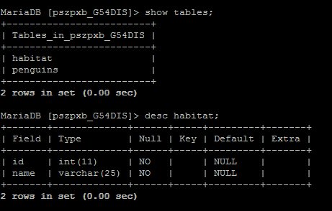
So now

Slide 12
Keys
Keys – these help the DBMS to make efficient searches
Key fields must be
Non null
Unique
They can be added on creation or afterwards

Slide 13
SQL PRIMARY KEY Constraint (see https://www.w3schools.com/sql/sql_primarykey.asp)
From the w3c web site
The PRIMARY KEY constraint uniquely identifies each record in a database table.
Primary keys must contain UNIQUE values, and cannot contain NULL values.
A table can have only one primary key, which may consist of single or multiple fields.

Slide 14
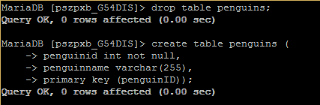
Add them when creating or afterwards
At creation
Note I dropped the table first as it already existed. Don’t do this if you have data somewhere already.

Slide 15
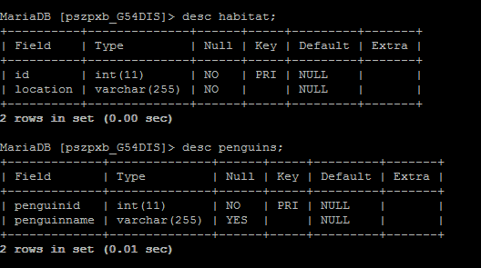
So I created both again

Slide 16
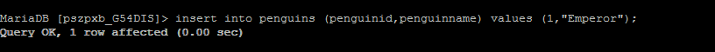
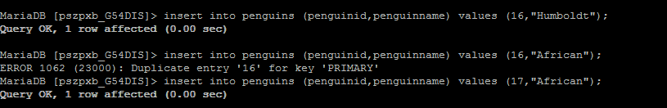
Now I will add some data to penguins
I added a few and made a mistake. I used the same ID twice

Slide 17
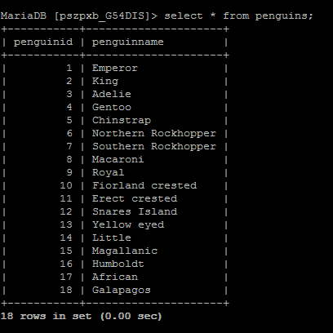
Now I can select from my data
* for select all attributes

Slide 18
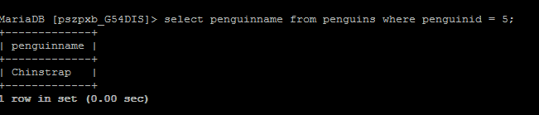
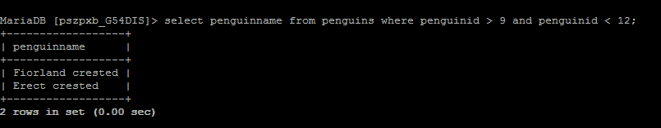
Where to add conditions

Slide 19
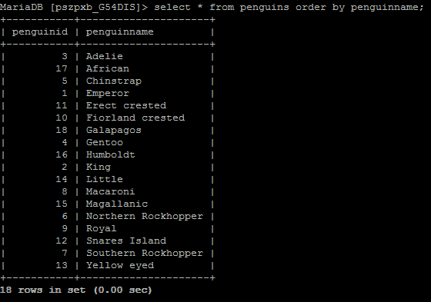
Order by to “sort”

Slide 20
Penguins to habitat
Is many to many
Several types of penguin live in Antarctic pack ice
Royal penguins live in 3 different locations
penguins
live in
habitat

Slide 21
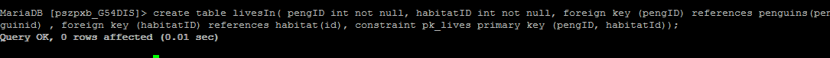
Need a link table
Interesting
The primary key in the penguins will be a foreign key in the link
So will the primary key in habitat
The combination will be the primary key for the link
I have called my link table livesIn

Slide 22
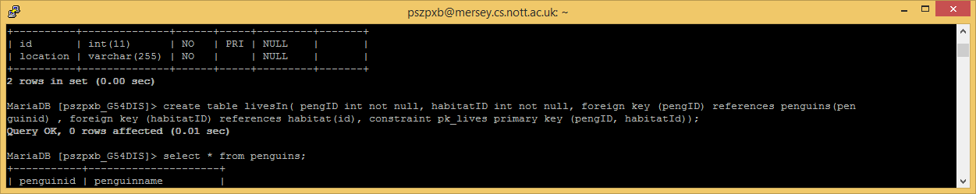

Slide 23
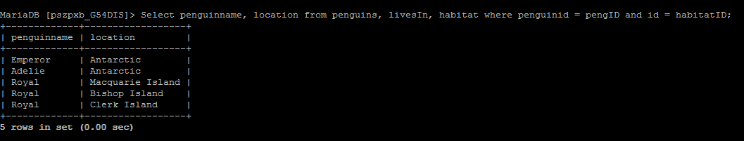
Added some links
Select penguinname, location from penguins,
livesIn, habitat
where penguinid = pengID and id = habitatID;
This forms a join between the three tables.

